Slide 1

MOBSF Demo Static Code Analysis of Android and IOS Applications
Praveen Kumar Krishnamoorthy
Date -

Slide 2
Agenda:
MOBSF Overview
Installation
Static Analysis of Android and IOS Application
Demo

Slide 3

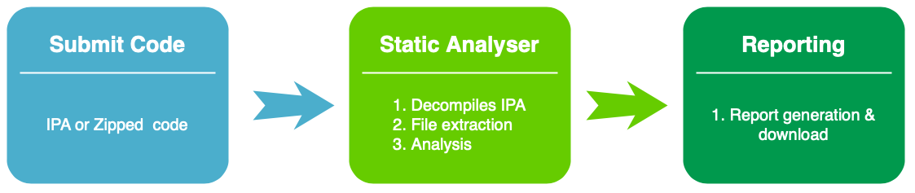
What is MOBSF:
Mobile Security Framework (MobSF) is an automated, all-in-one mobile application (Android/iOS/Windows) pen-testing, malware analysis and security assessment framework capable of performing static and dynamic analysis.

Slide 4





MobSF
Static Analysis
Android APK
Android Source ZIP (JAVA & Kotlin)
IOS IPA
IOS Source ZIP (Swift & Objective-C)
Windows APPX
Dynamic Analysis
Android APK
Genymotin Android VM
Android Studio Emulator

Slide 5
Installation:
Windows
Install Git
Install Python 3.8-3.9
Install JDK 8+
Install Microsoft Visual C++ Build Tools
Install OpenSSL (non-light)
Download & Install wkhtmltopdf
Add the folder that contains wkhtmltopdf binary to environment variable PATH.
git clone https://github.com/MobSF/Mobile-Security-Framework-MobSF.git
Move to Mobile-Security-Framework-MobSF folder
setup.bat
http://localhost:8000/
MobSF Docker Options (Static Analysis Only)
docker pull opensecurity/mobile-security-framework-mobsf
docker run -it --rm -p 8000:8000 opensecurity/mobile-security-framework-mobsf:latest
http://localhost:8000/

Slide 6
MobSF REST API for CI/CD:
MobSF - Circle CI, OWASP Glue - https://girlinjapan.net/running-mobsf-in-circleci-and-docker/
MobSF - Jenkins - https://riis.com/blog/pentesting_at_scale/
MobSF - Github Actions - https://github.com/marketplace/actions/github-action-for-mobsf

Slide 7
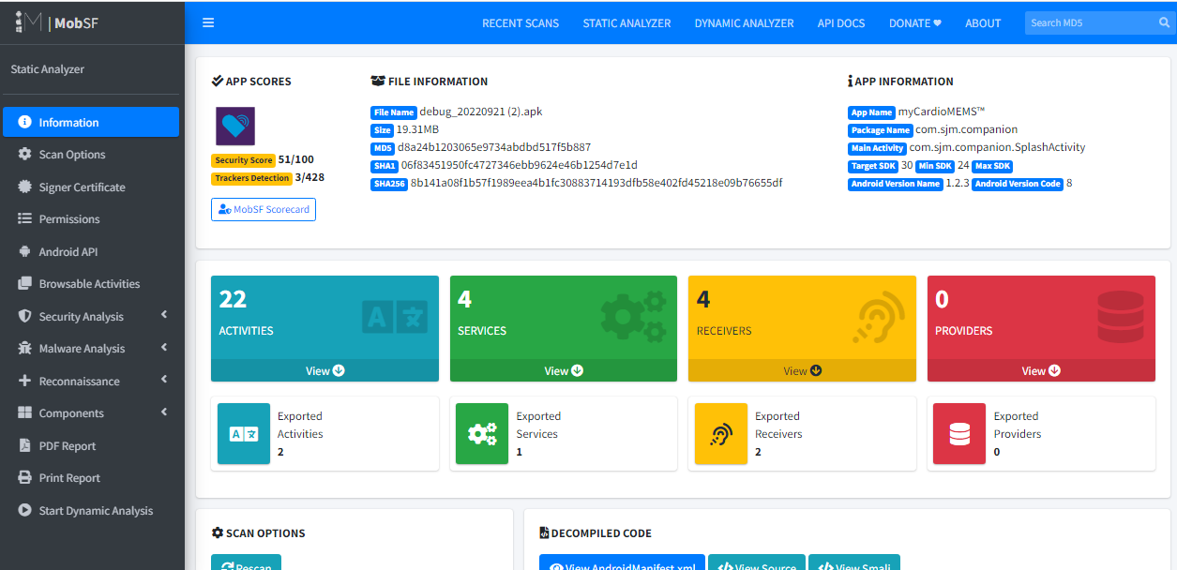
MobSF Android APK Analysis:
Parameters List
Information
Scan options
Signer certificate
Permissions
Android API
Browsable activities
Security analysis
Network Security Analysis
Manifest analysis
Code analysis
File Analysis
Malware analysis
APKID Analysis
Quality Analysis
Server Locations
Domain Malware Check
Components

Slide 8
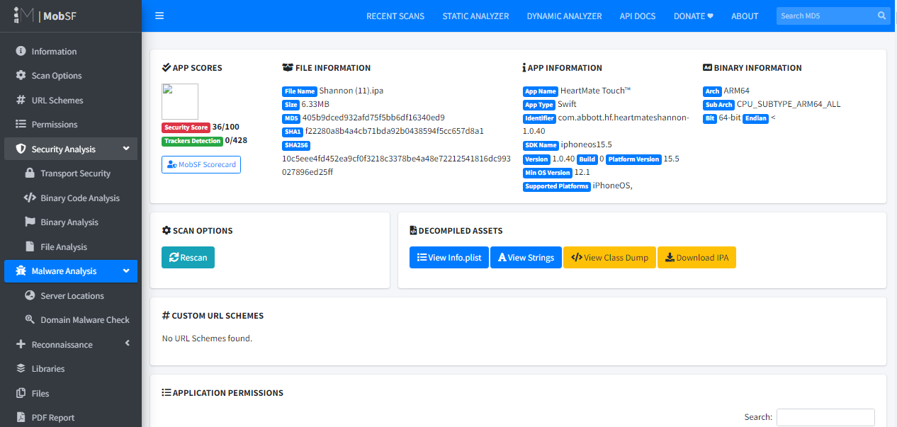
MobSF IOS IPA Analysis:
Parameters List
Information
Scan options
URL Schemes
Permissions
Security analysis
Transport Security
Binary Code analysis
Binary Analysis
File Analysis
Malware analysis
Server Locations
Domain Malware Check
Libraries
Files

Slide 9
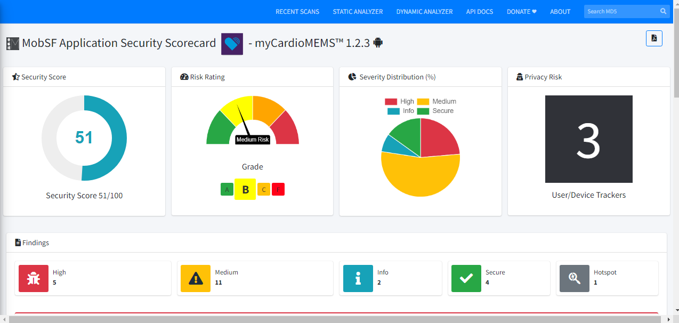
MobSF Scorecard:

Slide 10
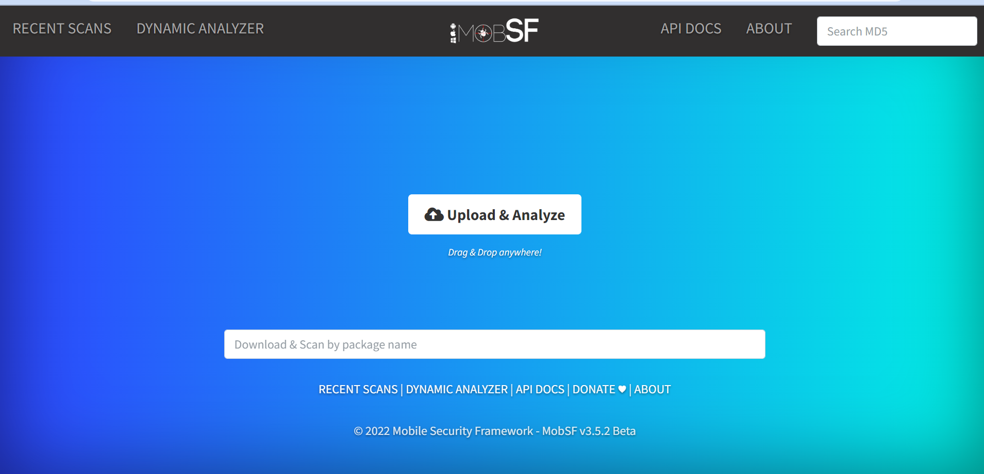
MobSF UI Dashboard:

Slide 11
Let’s see Demo
Praveen Kumar Krishnamoorthy
Date –

